Slide 1


Slide 2
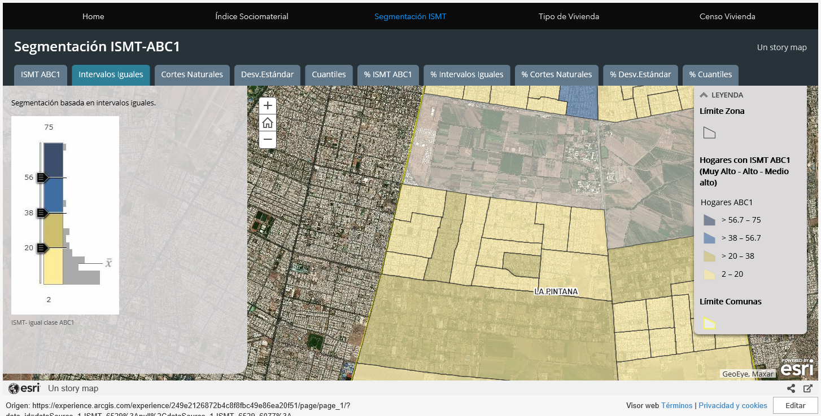
https://experience.arcgis.com/experience/249e2126872b4c8f8fbc49e86ea20f51/page/page_1/?data_id=dataSource_1-ISMT_6529%3Anull%2CdataSource_1-ISMT_6529_6077%3A

Slide 3
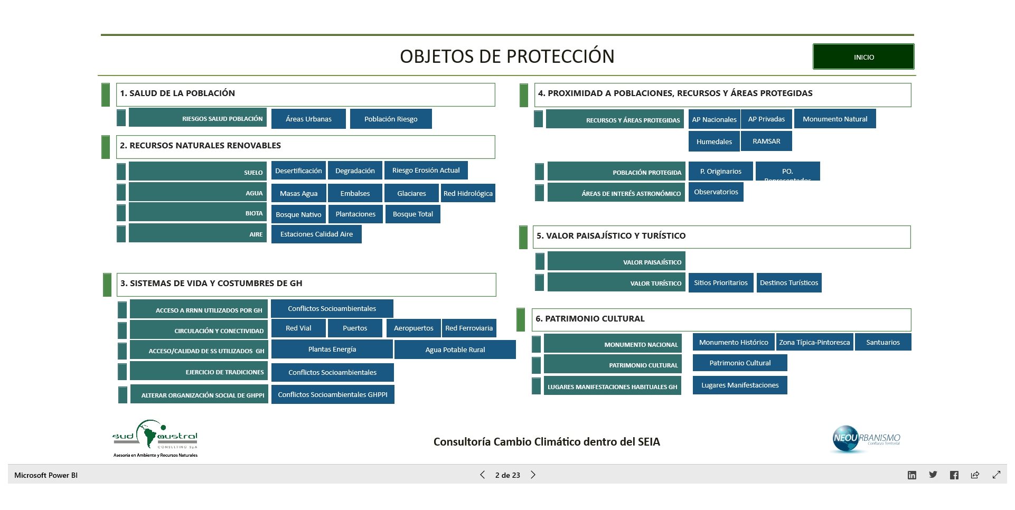

Slide 4
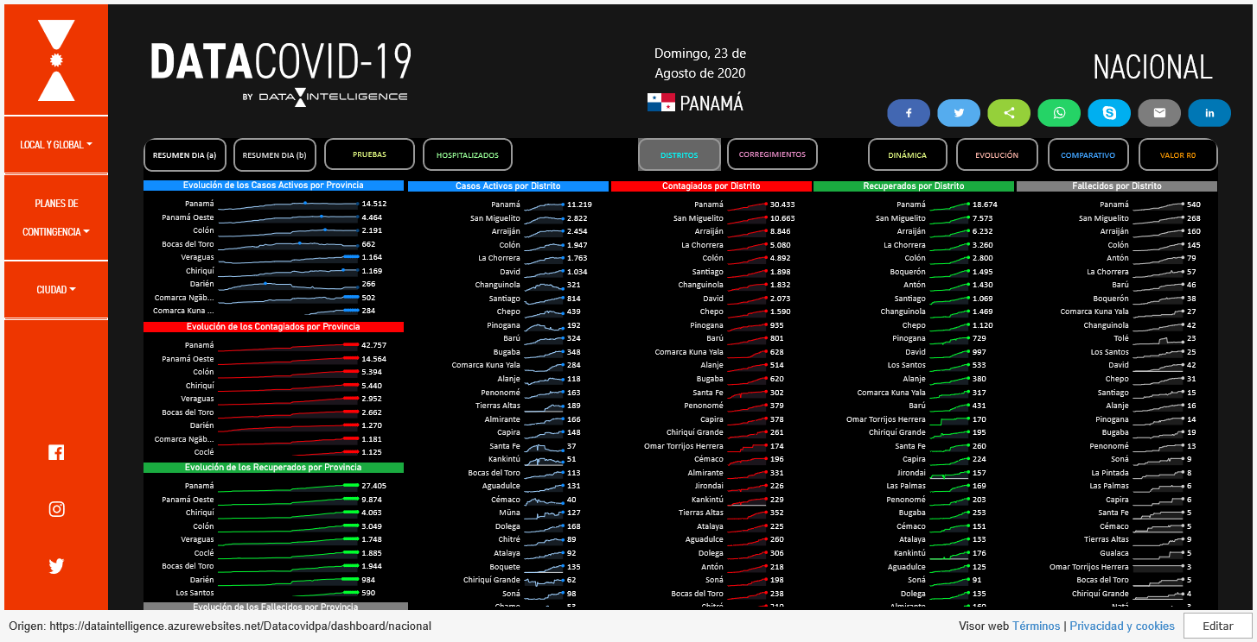

Slide 5
